Slide 1
Software Requirement Engineering Software Engineering Department Spring 2025
Muhammad Huzaifa Shah

Slide 2
Week Agenda
Introduction to Process Models
Traditional vs. Agile Requirements Engineering
Documenting Requirements
Quality Measurement in Requirements Engineering
Activity & Case Study

Slide 3
What is Documenting?
Documentation refers to the structured recording of information about a software project.
Helps developers, testers, and stakeholders understand project requirements and functionality.
Provides a reference for future modifications and maintenance.

Slide 4
Software Documentation
It is a written piece of text that is often accompanied by a software program.
This makes the life of all the members associated with the project easier.
It may contain anything from API documentation, build notes or just help content.

Slide 5
Types of Software Documentation
Requirement Documentation
Architectural Documentation
Technical Documentation
End-user Documentation

Slide 6
1. Requirement Documentation
It is the description of how the software shall perform and which environment setup would be appropriate to have the best out of it.
These are generated while the software is under development and is supplied to the tester groups too.

Slide 7
2. Architectural Documentation
Architecture documentation is a special type of documentation that concerns the design. It contains very little code and is more focused on the components of the system, their roles, and working.
It also shows the data flow throughout the system.

Slide 8
3. Technical Documentation
These contain the technical aspects of the software like API, algorithms, etc.
It is prepared mostly for software devolpers.

Slide 9
4. End-user Documentation
As the name suggests these are made for the end user.
It contains support resources for the end user i.e., user manuals etc.

Slide 10
Why is Documentation Important?
Ensures clarity and consistency in requirements.
Reduces ambiguity and misinterpretation.
Supports regulatory and compliance needs.
Facilitates communication among stakeholders.
Improves project traceability and management.

Slide 11
Types of Requirement Documents
Software Requirements Specification (SRS)
Use Case Diagrams & User Stories
Functional & Non-Functional Requirements
Traceability Matrix

Slide 12
1. Software Requirements Specification (SRS)
A Software Requirements Specification (SRS) is a detailed document that describes the system functionality, constraints, and technical specifications.
It serves as a contract (Validated Requirements) between stakeholders and developers, ensuring that the final product meets business and user expectations.
Typically follows industry standards like IEEE 830.

Slide 13
Why is SRS Important?
Provides clear documentation of system requirements, reducing miscommunication.
Serves as a reference for development, testing, and maintenance.
Ensures compliance with regulatory and security standards.
Facilitates project planning and risk management.

Slide 14
Characteristics of a Good SRS
Complete: Covers all aspects of the system.
Consistent: No conflicting requirements.
Unambiguous: Clearly defined, leaving no room for misinterpretation.
Verifiable: Can be tested to ensure compliance.
Feasible: Realistic within the constraints of budget, time, and technology.

Slide 15
Pros & Cons of SRS
Pros | Cons
Provides clarity & alignment | Can be time-consuming to create
Reduces development errors | Requires frequent updates for agile projects
Serves as a legal document | May lead to rigidity in implementation

Slide 16
Structure of an SRS Document (1/2)
Introduction
Purpose of the system
Scope
Definitions, Acronyms, and Abbreviations
Overall Description
System environment & constraints
Assumptions and dependencies
Functional Requirements
Detailed system functionalities and interactions

Slide 17
Structure of an SRS Document (2/2)
4. Non-Functional Requirements
Performance, security, usability, and reliability constraints
5. External Interface Requirements
User interfaces, hardware, and communication interfaces
6. System Models
Diagrams, use cases, and data flow models

Slide 18
Real-Life Example: SRS for an Online Banking System (1)
1. Introduction
Purpose: To design an online banking system that allows secure financial transactions.
Scope: Users can check balances, transfer funds, and manage accounts.
Acronyms & Abbreviations: PCI-DSS (Payment Card Industry Data Security Standard), MFA (Multi-Factor Authentication).

Slide 19
SRS for an Online Banking System (2)
2. Overall Description
System Constraints: The system must comply with PCI-DSS security standards.
Assumptions: Users will have stable internet connections.

Slide 20
SRS for an Online Banking System (3)
3. Functional Requirements
Users must log in using two-factor authentication (MFA).
The system must allow fund transfers between accounts.
Users can check account balances and download transaction history.
Admins must be able to generate account statements.

Slide 21
SRS for an Online Banking System (4)
4. Non-Functional Requirements
Transactions should process within 2 seconds.
The system must comply with PCI-DSS security standards.
The UI should be accessible for users with disabilities.
System uptime must be 99.9%.

Slide 22
SRS for an Online Banking System (5)
5. External Interface Requirements
User Interfaces: Web-based dashboard and mobile app.
Hardware Interfaces: The system should be compatible with fingerprint authentication on mobile devices.
Communication Interfaces: Secure API integrations for third-party payment processing.

Slide 23
SRS for an Online Banking System (6)
6. System Models
Use Case Diagrams:
Account login and verification.
Fund transfer authorization.
Sequence Diagrams:
User authentication flow.
Transaction approval process.

Slide 24
2. Use Case Diagrams & User Stories
2.1. Use Case Diagrams
A graphical representation of user interactions with a system.
Shows actors (users or other systems) and their interactions with various system functionalities.
Helps in understanding user-system interactions and designing system workflows.

Slide 25
Components of a Use Case Diagram
Actors: Represent users or external systems interacting with the application.
Use Cases: Specific actions or functionalities available to the user.
Relationships: Indicate how actors interact with use cases (e.g., associations, generalizations, and dependencies).
System Boundary: Defines the limits of the system being modeled.

Slide 26
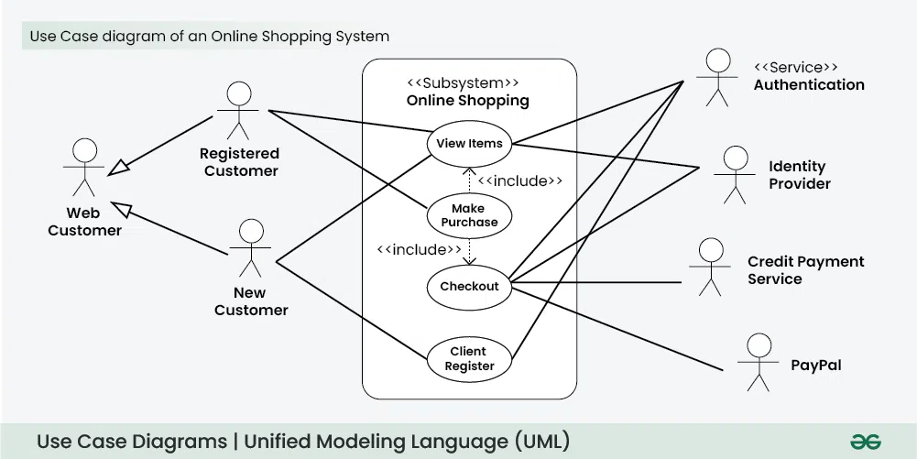
Use Case Diagram
Courtesy: https://www.geeksforgeeks.org/use-case-diagram/

Slide 27
2.2. User Stories
A simple, informal way to capture system functionalities from the user's perspective. Commonly used in Agile development to describe features concisely.
Structure of a User Story
Format: "As a [user role], I want to [feature] so that [benefit]."
Example: "As a customer, I want to reset my password so that I can regain account access."

